Slide 1

Introduction to MongoDB
STAT 474 – Techniques for Large Data Set
Notes:
Are your classroom colors different than what you see in this template? That’s OK! Click on Design -> Variants (the down arrow) -> Pick the color scheme that works for you!
Feel free to change any “You will…” and “I will…” statements to ensure they align with your classroom procedures and rules!

Slide 2
What is MongoDB?
MongoDB is the most popular NoSQL database system
Document-oriented database
Use JSON-like documents with “schemas”
Free, open-source, and cross-platform database system
You can download and install on your machine. https://docs.mongodb.com/manual/installation/
Several R packages have been created to interact with MongoDB. A fast and simple one is mongolite
R does not support document data structure; extracted data will be converted to data.frame or list

Slide 3
How are data organized in MongoDB
MongoDB is made up of databases which contain collections.
A collection is made up of documents.
Each document is made up of fields.
Collections can be indexed, which improves lookup and sorting performance.
Relational Concepts | MongoDB Equivalent
Database | Database
Table | Collection
Rows (Records) | Documents
Index | Index

Slide 4
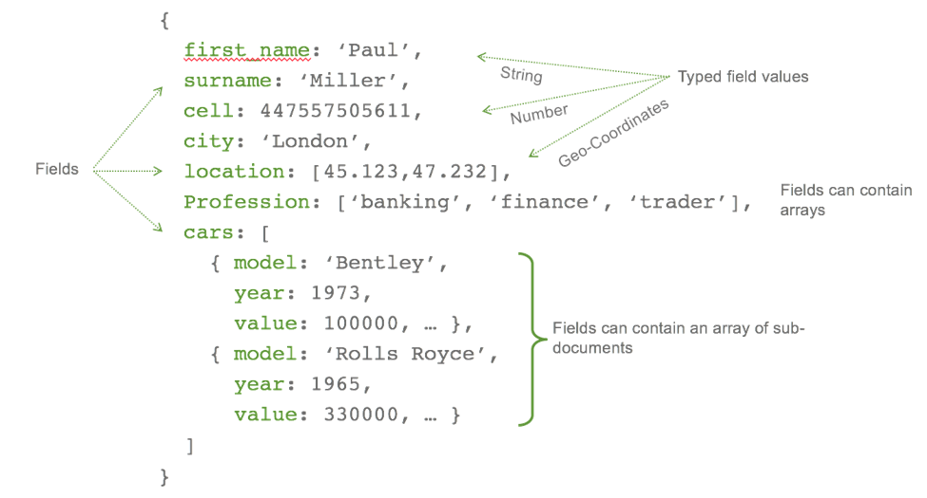
Example of a Document
Notes:
Location : in array

Slide 5
Documents in MongoDB
Inspired by JSON specification (http://www.json.org/)
Basic structure: a pair of key-value (a.k.a. field-value) in form of {string : value}, key in form of string
Values in field-value pairs can be geospatial, Date, arrays, subdocuments, etc.
Arrays in form: [string1 : value1, string2 : value2, ...., string_k:value_k]
Subdocuments: surrounding by {....}
JSON-type is text-based. MongoDB also support binary-encoded JSON format, called BSON

Slide 6
Documents in MongoDB

Slide 7
Demo in MongoDB shell

Slide 8
Basic CRUD operations in MongoDB
CRUD stands for creating, reading, updating and deleting
Creating via insert() function
Accepts data frame or JSON strings (one string for each document)
Atomicity: single document insertion is atomic, while multiple-document insertion is not.
We have worked with reading via find() function.
fields= option allows selection of listed fields
sort= option allows sorting
Deleting operation is straightforward
Drop the whole collection with drop(), or document with remove()

Slide 9
In-class Activity
Insert the following documents: {"name" : "Peter", "age" : 99, "loves": ["apple"]} {"name" : "Ruth", "age" : 93, "loves": ["apple", "sugar"]} {"name" : "Jack", "loves" : ["bananas"]}
Check with find() to see if everything is insert correctly
What do you observe with the following query: find('{}', sort = '{"age" : 1}')
What happen when you change the number 1? Try other numbers, including -1. Comment and take note to yourself about the sorting feature.

Slide 10
Updating in MongoDB
The function update() takes two arguments: the selector (i.e. WHERE in SQL) to use and what updates to apply to fields. update('{"name" : "Peter"}', '{"$set" : {"age" : 90}}')
Activity: Verify the effect of updating command. What happens if you forget the $set operator?

Slide 11
Updating in MongoDB
Adding value to an array:
update('{"name" : "Peter"}', '{"$push" : {"loves" : "candy"}}')
Question: What happens if we mistakenly use $set?
Upserts = update document if found; otherwise insert.
update('{"name": "Bob"}', '{"$inc":{"age" : 1}}', upsert = T)
Question: What do you observe when running the above query? Comment on the effect of $inc?
Question: Add a field vaccinated (Boolean type) with value TRUE for all documents.

Slide 12
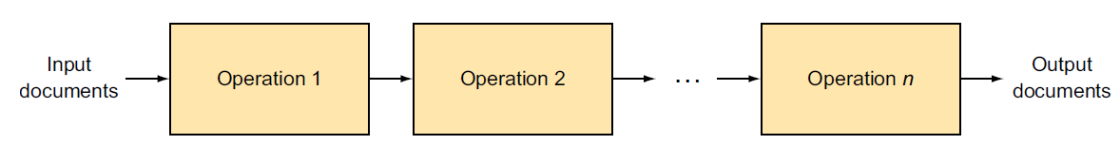
Aggregation Framework
An advance query language to transform and combine data from multiple documents.
The MongoDB's equivalence to the SQL's GROUP BY clause.
A call to the aggregation framework defines a pipeline, the aggregation pipeline, where the output from each step in the pipeline provides input to the next step.

Slide 13
SQL command | Aggregation operator | Meaning
SELECT | $project | Specify fields in the output document
 | $group functions | Ex: $sum, $avg, $min, $max, $first, $last
FROM |  | Specify in collection$aggregate(...)
JOIN |  | There is no join in MongoDB
 | $unwind | Expand an array, one document for each array entry
WHERE | $match | Select documents to be processed
GROUP BY | $group | Group documents by a specified key
HAVING | $match | Select documents to be processed
ORDER BY | $sort | Sort documents
LIMIT | $limit | Limit the number of output documents
 | $out | Write the results to a collection

Slide 14
Example – Zipcodes collection
Activity: Look at the collection and query one document. What does it look like?
Question: Write a SQL query to return states with populations above 10 million
In MongoDB:
zipcodes$aggregate([ {"$group": {"_id": "$state", "totalPop":{"$sum": "$pop"}}}, "$match": {"totalPop":{"$gte":10000000}}} ])
The dollar sign ($) refers to the field in the document.

Slide 15
Grouping in Aggregate Framework
$group operator always has “_id”:$<field name>
Grouping with multiple fields:
{"$group" : {"_id":{"state" : "$state",
"city" : "$city"} } }
Question: What does this query do?
example$aggregate('[ {"$unwind" : "$loves"}, {"$group" :{"_id" : "$loves", "total" : {"$sum" : 1}}}, {"$sort": {"total" : -1}}, {"$limit" : 1} ]')

Slide 16
In-Class Exercise
Return Average City Population by State
Return 10 cities with the most number of zip codes. Note: different states might have cities with the same name.
Return the largest cities by each state.

